Slide 1

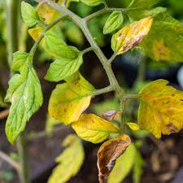
VIKAS GROUP OF INSTITUTIONS
Tomato leaf disease detection
TEAM MEMBERS:
T. SAI TEJA REDDY :209T1A0579
CH. GURU PUJITHA :209T1A0519
Y. BHARGAVA RAMA RAJU :209T1A0587
N. RAMBABU :209T1A0562
INTERNAL GUIDE:
J VENKATA RAO

Slide 2

ABSTRACT
By analyzing leaf photos the system detects various line efficiency early detection contributes to better agriculture production .India is a land of agriculture and mainly known for growing variety of crops. Around half of the population in India depend on agriculture. Diseases to the crops may affect the livelihood of the farmers. In order to overcome this major problem, a robot that detects the leaf disease using image processing and deep learning is deployed.

Slide 3
INTRODUCTION
AIM :
The aim of tomato leaf disease detection is primarily to identify and diagnose diseases affecting tomato plants at an early stage..
PROBLEM STATEMENT :
Timely detection and accurate diagnosis of these diseases are crucial for effective disease management and ensuring sustainable crop yields.
PURPOSE:
The primary purpose is to detect diseases affecting tomato plants at an early stage. Early detection allows for prompt intervention, preventing the spread of diseases and minimizing crop losses.

Slide 4
EXISTING SYSTEM
The existing systems for tomato leaf disease detection typically rely on manual inspection by agricultural experts or farmers, which can be time-consuming, labor-intensive, and prone to errors.
Drawbacks:
Labor-Intensive
Time-Consuming
Expertise Dependency
Limited Scalability
Inability to Detect Early Symptoms

Slide 5
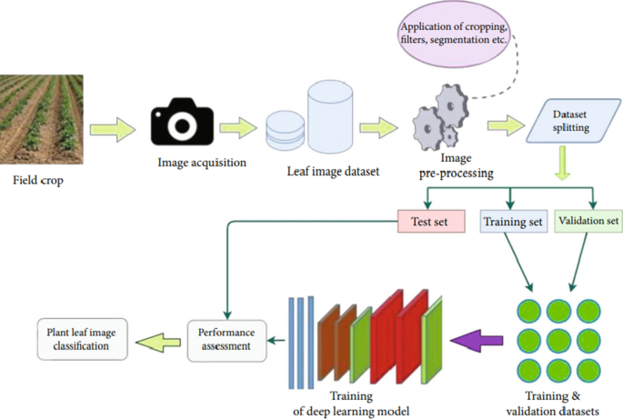
PROPOSED SYSTEM
Detecting tomato leaf diseases using Convolutional Neural Networks (CNNs) involves training a deep learning model to accurately classify images of tomato leaves into healthy or diseased categories.
Advantages:
High Accuracy
Automated Detection
Adaptability to Variability
Cost-Effectiveness
Continuous Improvement
Speed and Efficience

Slide 6
SYSTEM ANALYSIS
SOFTWARE REQUIREMENTS HARDWARE REQUIREMENTS
OPERATING SYSTEM : Windows11 PROCESSOR :amd ryzan5
PROGRAMMING LANGUAGE : python SPEED :1.1-3.4gHZ
VERSION : python3.9.0 RAM :8GB
IDE : PyCharm HARDDISK :512

Slide 7
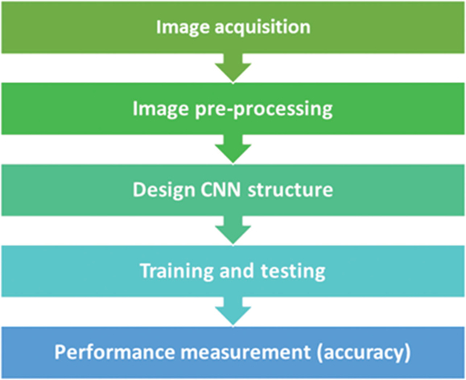
PROJECT LIFE CYCLE
Data Collection :
Dataset of tomato leaf images containing both healthy leaves and leaves infected with various diseases.
Data Preprocessing :
Resize images to a uniform size suitable for CNN input . Normalize pixel values to a common scale.
Architecture Design:
Choose a pre-existing CNN architecture suitable for image classification tasks, such as VGG, ResNet , or Inception.
Model Training:
Split the dataset into training, validation, and testing sets . Train the CNN model on the training data using techniques.
Model Evaluation:
Evaluate the trained model's performance using metrics like accuracy, precision, recall.

Slide 8
MODULES
PANDAS: Pandas is a software library written for the Python programming language for data manipulation and analysis.
NUMPY: NumPy is a library for the Python programming language, adding support for large, multi-dimensional arrays and matrices, along with a large collection of high-level mathematical functions to operate on these arrays.
SEABORN : Seaborn is a library for making statistical graphics in Python. It builds on top of matplotlib and integrates closely with pandas data structures.
OPEN CV : OpenCV is a great tool for image processing and performing computer vision tasks. It is an open-source library that can be used to perform tasks like face detection, objection tracking, landmark detection, and much more.
MATPLOTLIB: Matplotlib is a comprehensive library for creating static, animated, and interactive visualizations in Python. Matplotlib makes easy things easy and hard things possible.

Slide 9



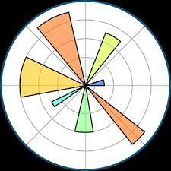

NECESSARY MODULES
Keras
Installation command:
‘pip install keras’
OpenCV
Installation command:
‘pip install opencv-python’
Matplotlib
Installation command:
‘pip install matplotlib’
TensorFlow
Installation command:
‘pip install tensorflow’
Scikit-learn
Installation command:
‘pip install scikit-learn

Slide 10
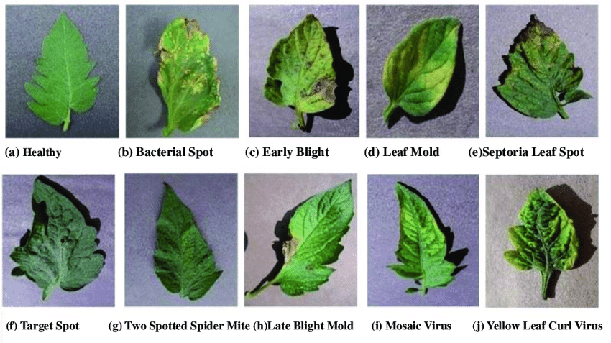
DIFFERENT LEAF CATEGORIES

Slide 11
DATA SET AND IMPLEMENTATION
DATA SET DETAILS
A simple CNN model to detect and classify ten different types of tomato leaf disease. Dataset taken from Kaggle. Link - https://www.kaggle.com/noulam/tomato.
TECHNOLOGY USED:
Python : Used as the primary programming language for development.
TensorFlow and Keras: Employed for building and training deep learning models.
OpenCV: Utilized for image processing tasks, including cropping, resizing, and feature extraction.
Matplotlib: Used for data visualization, including plotting graphs and visualizing model performance.
Scikit-learn: Applied for deep learning tasks such as data preprocessing, model evaluation, and metric calculation.

Slide 12

MODEL ARCHITECTURE
Input Layer
Convolutional Layers
Flattening Layer
fully Connected Layers
Pooling Layers
The input layer receives the tomato leaf images as input data. Each image is represented as a grid of pixel values.
These layers consist of neurons that are connected to all neurons in the previous layer. They perform complex transformations on the flattened feature vectors to learn high-level representations of the input data.
These layers consist of filters (small grids) that slide over the input images, extracting features such as edges, textures, and patterns. Each filter produces a feature map by performing convolution operations.
Pooling layers reduce the spatial dimensions of the feature maps, helping to decrease computational complexity and prevent overfitting. Max pooling, a common pooling technique, selects the maximum value from each region of the feature map.
After several convolutional and pooling layers, the feature maps are flattened into a one-dimensional vector. This prepares the data for input into the fully connected layers.

Slide 13
DATA PREPROCESSING
Image Resizing:
Resizing the images to a standard size can help in reducing computational complexity and ensuring uniformity in the dataset.
Color Space Conversion:
Converting images to different color spaces such as RGB, HSV, LAB, or YCbCr can sometimes improve the discrimination of the leaf from the background, depending on the specific characteristics of the images.
Edge Detection:
Edge detection algorithms such as Canny edge detection can be employed to highlight the boundaries of objects in the image, which can aid in distinguishing the leaves from the background.
Normalization:
Help in reducing the effects of variations in illumination and ensuring that the model learns features that are invariant to such variations.

Slide 14
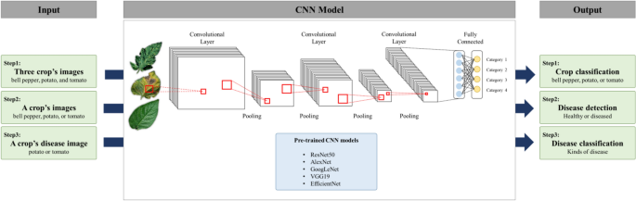

Slide 15
EVALUATION
Accuracy: The proportion of correctly classified instances out of the total number of instances.
Precision: The ratio of true positive predictions to the total number of positive predictions, indicating the model's ability to avoid false positives.
Recall (Sensitivity): The ratio of true positive predictions to the total number of actual positive instances, indicating the model's ability to capture all instances of a particular disease.
Confusion Matrix: A matrix showing the counts of true positive, true negative, false positive, and false negative predictions, which can be used to calculate various performance metrics.
Receiver Operating Characteristic (ROC) Curve and Area Under the Curve (AUC): Useful for evaluating binary classification models, particularly when considering different thresholds for class prediction.
Cross-Validation: Techniques such as k-fold cross-validation can be employed to ensure robust evaluation by training and testing the model.

Slide 16
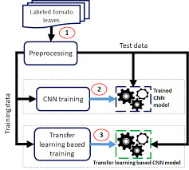
MODEL EVALUATION
Validation Set Performance:
After training the model, it's crucial to assess its performance on a separate validation set.
The validation set consists of data that the model hasn't seen during training, ensuring an unbiased evaluation of its generalization ability.
Test Set Performance:
Once the model is fine-tuned based on validation set performance, its final performance is evaluated on an independent test set.
The test set provides a realistic estimation of the model's effectiveness in real-world scenarios, as it represents unseen data.
Interpretation of Results:
The accuracy metric measures the proportion of correctly classified samples out of the total samples in the validation and test sets.

Slide 17
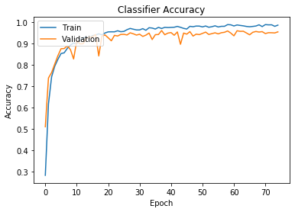
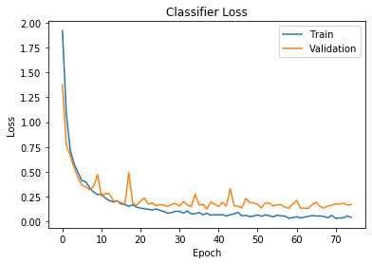
RESULTS
Training
A validation split 20% was used. The model was trained on 14676 images and validated on 3669 images for 75 epochs (50 epochs will do just fine). The training accuracy was 98.63% while that of validation was 95.48%.

Slide 18
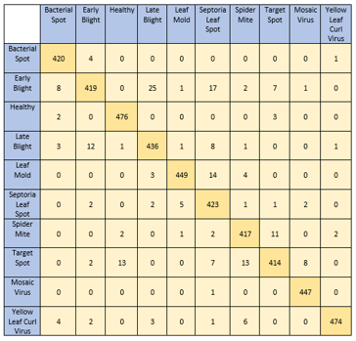
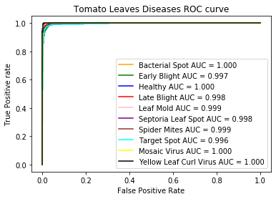
RESULTS
Testing
Testing of the model was done on 4585 images. The accuracy was found to be 95.42%. The ROC-AUC score was also calclulated and for each category of disease the AUC score was greater than 0.95.

Slide 19
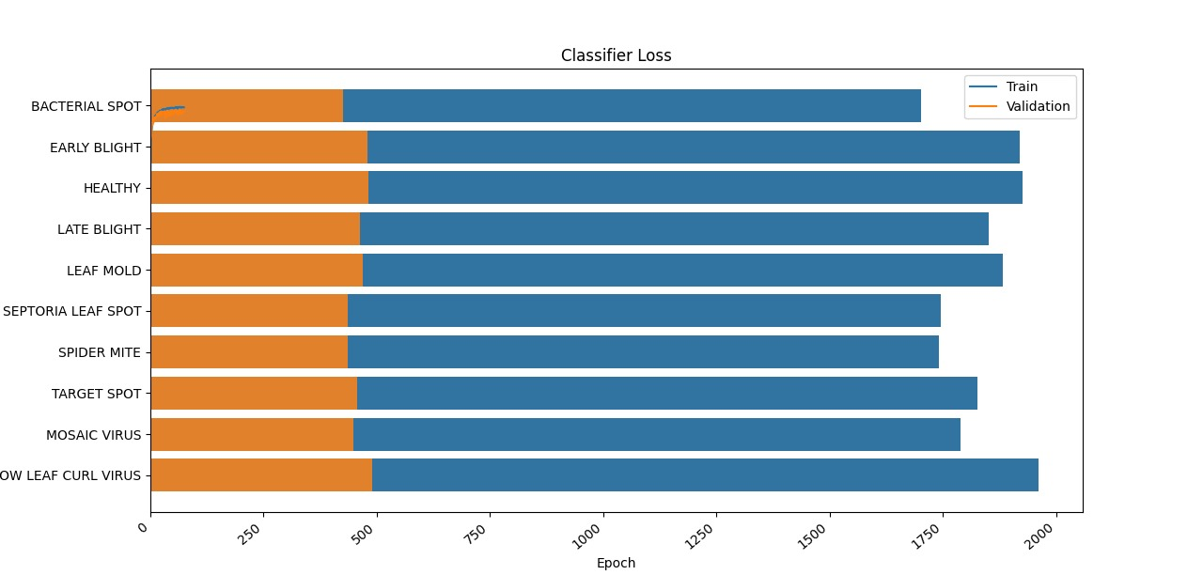

Slide 20
FUTURE SCOPE AND ENHANCEMENT
Future scope refers to the planned additions or enhancements that a software product intends to incorporate in future versions. It outlines the range of new features and improvements envisioned for the product, guiding development efforts to meet user needs and market trends effectively.
Multi-Class Classification
Transfer Learning and Domain Adaptation
Interactive Decision Support Systems
Multi-Modal Fusion
Collaborative Platforms and Crowdsourcing
Continuous Monitoring and Feedback Loop

Slide 21
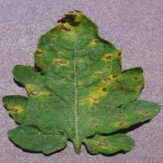

CONCLUSION
This project presents an automated, low cost and easy to use end-to end solution to one of the biggest challenges in the agricultural domain for farmers – precise, instant and early diagnosis of crop diseases and knowledge of disease outbreaks - which would be helpful in quick decision making for measures to be adopted for disease control High performing deep CNN model “Inception” enables real time classification of diseases in the Cloud platform via a user facing mobile app.

Slide 22

Thank you
By Batch no : 10

